Slide 1
Tableau

Slide 2
What is Tableau
Tableau is a powerful data visualization tool used in the field of business intelligence. It helps users create a variety of charts, graphs, maps, dashboards, and stories to make data understandable and actionable

Slide 3
Here are some key features and aspects of Tableau:
Data Visualization: Tableau excels in converting raw data into visually appealing and interactive dashboards. Users can easily create visualizations by dragging and dropping elements onto a canvas.
Ease of Use: With its intuitive interface, Tableau allows users with little to no technical skills to create complex visualizations. It provides a drag-and-drop functionality that simplifies the process of data analysis.
Data Connectivity: Tableau can connect to a wide range of data sources, including databases (like MySQL, SQL Server, Oracle), cloud services (like Google Analytics, AWS), spreadsheets (like Excel), and many more.
Interactive Dashboards: Tableau dashboards are highly interactive and allow users to drill down into data, filter views, and interact with visual elements for a deeper understanding of the underlying data.

Slide 4
Real-time Data: Tableau can handle real-time data feeds, making it useful for dynamic data analysis and monitoring key performance indicators (KPIs) in real-time.
Advanced Analytics: It supports advanced analytics with features such as trend lines, forecasting, and statistical analysis. Users can also integrate Tableau with programming languages like R and Python for more complex data analysis.
Collaboration and Sharing: Tableau provides tools for sharing visualizations and dashboards with others. Tableau Server and Tableau Online allow users to publish dashboards to a central location where others can access and interact with them.
Customization: Users can customize the look and feel of their visualizations to align with their brand or specific needs. This includes adjusting colors, fonts, and layout.
Scalability: Tableau can handle large datasets and complex data models, making it suitable for organizations of all sizes, from small businesses to large enterprises.

Slide 5
Tableau vs Excel
Tableau and Excel are both powerful tools used for data analysis and visualization, but they serve different purposes and have distinct features. Here’s a comparison highlighting their key differences:

Slide 6
Purpose and Use Cases
Excel: Primarily a spreadsheet application used for data entry, manipulation, and basic analysis. It is widely used for financial modeling, budgeting, and simple data visualizations.
Tableau: A specialized data visualization and business intelligence tool designed for creating interactive and complex visualizations. It excels at transforming large datasets into actionable

Slide 7
Data Visualization
Excel: Offers basic charting capabilities such as bar charts, line charts, pie charts, and scatter plots. Customization options are available, but they are more limited compared to specialized tools.
Tableau: Provides advanced and highly interactive visualizations including heat maps, tree maps, geographic maps, and dashboards. It supports more complex visual representations and interactive features.
Data Handling
Excel: Handles data within individual spreadsheets and can manage moderately sized datasets. Performance can degrade with very large datasets.
Tableau: Designed to handle large and complex datasets efficiently. It can connect to various data sources simultaneously and process large volumes of data without significant performance issues.

Slide 8
Data Connectivity
Excel: Can connect to a variety of data sources such as databases, web services, and other spreadsheets. However, the process can be less seamless compared to Tableau.
Tableau: Offers robust data connectivity options. It can connect to numerous data sources including SQL databases, cloud services, big data platforms, and more. Tableau provides real-time data connectivity and integration.
Usability
Excel: Known for its ease of use for basic data tasks. Most professionals are familiar with its interface and functionalities. It is versatile for various non-visual data tasks like calculations, pivot tables, and data cleaning.
Tableau: Designed with a focus on user-friendly data visualization. Its drag-and-drop interface allows users to create complex visualizations with minimal technical skills. However, it is less suited for detailed data manipulation tasks that Excel handles well.

Slide 9
Advanced Analytics
Excel: Supports basic statistical analysis and can perform more complex calculations using built-in formulas and functions. Advanced analytics often require add-ins or external tools.
Tableau: Includes built-in advanced analytics features such as trend analysis, forecasting, and clustering. It can integrate with programming languages like R and Python for deeper analytical capabilities.
Collaboration and Sharing
Excel: Collaboration is possible but can be cumbersome, often requiring shared drives or email exchanges. Excel Online offers some collaborative features.
Tableau: Provides robust sharing and collaboration options through Tableau Server and Tableau Online. Users can publish and share interactive dashboards with colleagues, who can view and interact with them in real-time.
Advanced Analytics
Excel: Supports basic statistical analysis and can perform more complex calculations using built-in formulas and functions. Advanced analytics often require add-ins or external tools.
Tableau: Includes built-in advanced analytics features such as trend analysis, forecasting, and clustering. It can integrate with programming languages like R and Python for deeper analytical capabilities.
Collaboration and Sharing
Excel: Collaboration is possible but can be cumbersome, often requiring shared drives or email exchanges. Excel Online offers some collaborative features.
Tableau: Provides robust sharing and collaboration options through Tableau Server and Tableau Online. Users can publish and share interactive dashboards with colleagues, who can view and interact with them in real-time.

Slide 10
Scalability
Excel: Best suited for individual or small team use and for smaller datasets. Its performance can degrade with very large data volumes.
Tableau: Scales well to large teams and organizations. It is designed to handle big data and complex data environments efficiently.
Summary
Excel is best for:
Data entry and storage
Financial modeling and budgeting
Simple data analysis and visualization
Detailed data manipulation and calculations
Tableau is best for:
Advanced and interactive data visualizations
Handling large and complex datasets
Real-time data analysis and monitoring
Sharing and collaboration on data insights

Slide 11
Tableau Desktop
Tableau Desktop is a professional-grade, standalone application used for creating and analyzing data visualizations.
Advanced Features: Offers a wide range of advanced analytics and visualization tools, including complex calculations, predictive analysis, and sophisticated chart types.
Data Connectivity: Can connect to a vast array of data sources including local files (Excel, CSV), databases (SQL Server, Oracle, MySQL), cloud services (Google Analytics, Salesforce), and big data platforms (Hadoop).
Customization: Highly customizable dashboards and visualizations. Users can format charts, apply filters, and create interactive elements.
Data Preparation: Includes tools for data cleaning, blending, and transformation, enabling users to prepare data for analysis within the application.
Local and Server Publishing: Allows users to save their work locally or publish dashboards to Tableau Server or Tableau Online for sharing and collaboration within an organization.
Security: Offers robust security features for data access and sharing, ensuring data privacy and compliance with organizational policies.

Slide 12
Tableau Public
Tableau Public is a free, cloud-based version of Tableau designed for sharing visualizations with the public.
Cost: Free to use, making it accessible for students, educators, bloggers, and anyone interested in data visualization.
Data Connectivity: Limited compared to Tableau Desktop. Connects to data sources such as Excel, Google Sheets, and some web data connectors, but lacks extensive database connectivity.
Public Sharing: All visualizations created in Tableau Public must be saved to the Tableau Public server, meaning they are publicly accessible. This makes it ideal for public-facing projects but unsuitable for sensitive or confidential data.
Community and Exposure: Visualizations published to Tableau Public can be seen and interacted with by anyone, which is great for gaining exposure, sharing insights, and contributing to the data visualization community.
Feature Limitations: Lacks some advanced features available in Tableau Desktop, such as certain data preparation and advanced analytics functionalities.

Slide 13
Data types in tableau
Data types define the kind of data that can be stored in a field. Correctly identifying and understanding data types is crucial for effective data analysis and visualization. Tableau automatically detects data types when you import data, but you can also manually change them if needed. Here are the primary data types in Tableau:
1. String (Text)
Description: Represents text data.
Usage: Used for categorical data such as names, categories, and other non-numeric data.
Examples: "John Doe", "Product A", "New York"
2. Number (Numeric)
Description: Represents numeric data.
Subtypes:
Integer: Whole numbers without decimals.
Examples: 1, 42, -7
Decimal (Floating-point): Numbers with decimals.
Examples: 3.14, -0.001, 2500.75
Usage: Used for quantitative data such as sales figures, counts, and measurements.

Slide 14
3. Date and Time
Description: Represents dates and times.
Subtypes:
Date: Contains only date information.
Examples: "2024-06-02", "2021-12-25"
Date & Time: Contains both date and time information.
Examples: "2024-06-02 14:30:00", "2021-12-25 08:45:00"
Usage: Used for temporal data analysis such as trends over time, time series
analysis, and event tracking.
4. Boolean
Description: Represents binary data.
Values: True/False or Yes/No
Usage: Used for logical operations, conditions, and filters.

Slide 15
5. Geographical
Description: Represents geographical data.
Subtypes:
Country/Region
State/Province
City
Postal Code
Latitude and Longitude
Usage: Used for mapping data and geographical analysis. Tableau
recognizes these data types and can plot them on maps.

Slide 16
Column formatting
Column Name [Changing to new name or resetting it back)
Splitting columns using delimiter.
Sorting columns. [headers]
Sorting column. [values]
Delete the column

Slide 17
Understanding Drill-Down Hierarchy
A hierarchy in Tableau typically consists of fields that have a natural hierarchical relationship. For example:
Geographic Hierarchy: Country > State/Province > City
Time Hierarchy: Year > Quarter > Month > Day
Product Hierarchy: Category > Sub-Category > Product Name

Slide 18
Ways of sorting in tableau charts
Quick sort
Toolbar sort
Pills sort
Marks card sort

Slide 19
Groups are a feature that allows you to combine multiple dimension members into a single, higher-level category. This is useful for simplifying and organizing your data, making it easier to analyze and visualize. For instance, you might group various product types into broader categories, or several regions into a single territory.
Measures are quantitative data that you can aggregate and analyze. They represent the numeric values on which you perform calculations like sums, averages, minimums, maximums, and other statistical operations. Measures are essential for creating meaningful visualizations and insights from your data.
Understanding Measures
Measures typically include:
Sales amounts
Profit margins
Quantities
Costs
Any other numeric data that can be mathematically operated upon

Slide 20
Types of Aggregations
SUM: Total of all values.
AVG: Average of all values.
MEDIAN: Middle value in a sorted list.
COUNT: Number of values.
COUNTD: Number of distinct values.
MIN: Smallest value.
MAX: Largest value
Measures in Tableau are the backbone of data analysis, enabling you to quantify and analyze various aspects of your data. By understanding how to effectively use and manipulate measures, you can create insightful visualizations and dashboards that drive informed decision-making. Whether using basic aggregations or complex calculated fields, measures help transform raw data into actionable insights.

Slide 21
Discrete vs. Continuous
Discrete Data
Definition: Discrete data consist of distinct and separate values. These values are often categorical and can be counted but not measured.
Representation: In Tableau, discrete data fields are shown as blue pills in the Data Pane and on the shelves.
Visualization: Discrete data typically create headers or labels in charts, like categories in a bar chart or points in a scatter plot.
Examples:
Product categories (e.g., Furniture, Office Supplies, Technology)
Customer segments (e.g., Small Business, Corporate)
Months (e.g., January, February

Slide 22
Discrete vs. Continuous
Continuous Data
Definition: Continuous data represent values that fall on a continuum and can be measured but not counted. They are numeric and can take on any value within a range.
Representation: In Tableau, continuous data fields are shown as green pills in the Data Pane and on the shelves.
Visualization: Continuous data typically create axes in charts, like a continuous axis in a line chart or histogram.
Examples:
Sales amounts (e.g., $1000, $5000)
Profit margins (e.g., 10%, 20%)
Dates (when treated as a continuous range)

Slide 23
Measures and Dimensions
Measures
Definition: Measures are quantitative data that can be aggregated and are used for mathematical operations.
Usage: Measures are typically analyzed numerically, such as summing sales or averaging profits.
Examples:
Sales
Profit
Quantity
Discount

Slide 24
Measures and Dimensions
Dimensions
Definition: Dimensions are qualitative data that provide context for measures. They are used to segment data.
Usage: Dimensions are often used to slice and dice the data, providing categories for analysis.
Examples:
Product Name
Customer Segment
Region
Order Date

Slide 25
Parameters and Sets
Parameters and sets are powerful features in Tableau that enhance interactivity and flexibility in your data visualizations. They allow users to dynamically change the view and filter data based on specific conditions.
Parameters
Parameters are dynamic values that can be used to control various aspects of a Tableau visualization. They can be integers, floats, dates, strings, or even Boolean values. Parameters are single-valued and user-driven, meaning the user can select or input a value, and that value can be used to modify calculations, filters, reference lines, and more.
Sets
Definition
Sets are custom fields that define a subset of your data based on specific conditions. They can be static (fixed) or dynamic (computed), allowing for flexible data segmentation and analysis.

Slide 26
Uses of Parameters
Filtering Data: Create dynamic filters that change based on parameter values.
Calculations: Use parameters in calculated fields to change the logic dynamically.
Reference Lines: Adjust reference lines based on parameter values.
Top N Analysis: Display the top N items, where N is determined by the parameter value.
Uses of Sets
Filtering Data: Use sets to include or exclude specific data points.
Comparisons: Compare members of a set against the rest of the data.
Highlighting: Highlight specific data points within a visualization.
Conditional Formatting: Apply different formatting or calculations based on set membership.
Top N Analysis: Identify top or bottom performers based on a measure.

Slide 27
Combined Fields:
Combined fields (or compound keys) are used to create a single field that combines two or more fields. This can be helpful when you need a unique identifier that spans multiple fields.

Slide 28
Title
Definition: A title is the heading that appears at the top of a worksheet or dashboard. It gives an immediate context or summary of the content being displayed.
Uses:
To provide a clear, descriptive name for the visualization or dashboard.
To give viewers an immediate understanding of what the chart or dashboard is about.
To include important information such as the data source, date range, or key metrics.

Slide 29
Caption
Definition: A caption is a text element that appears at the bottom of a worksheet or dashboard. It provides additional information, explanations, or context that might not be immediately evident from the visualization itself.
Uses:
To provide detailed descriptions or explanations of the data being presented.
To include notes about data sources, methodology, or any assumptions made in the analysis.
To give credit or reference to external data sources.
To highlight important findings or insights that viewers should take note of.

Slide 30
Exporting options
1. Save
2. Pdf
3. Image
4. Data file
5. To excel
6.Copy

Slide 31
Granularity
Granularity in Tableau (and data analysis in general) refers to the level of detail or specificity of the data being analyzed. It determines how detailed or summarized the data points are in your visualization.
Understanding Granularity
High Granularity: This means the data is very detailed. For example, if your data includes individual sales transactions, each row might represent a single sale, including the exact date and time, the specific product sold, and the customer who bought it.
Low Granularity: This means the data is more summarized. For example, if you aggregate sales data by month, each row might represent the total sales for a specific month, regardless of the specific transactions.

Slide 32
Filters
General (checking out exclude)
Wildcard
Conditional
Top

Slide 33
Charts
Charts in Tableau are visual representations of data that help users to understand and analyze patterns, trends, and relationships within the data. Tableau offers a wide variety of chart types, each suited to different kinds of data and analysis needs.
Bar Chart
Line Chart
Pie Chart
Scatter Plot
Area Chart
Map
Histogram

Slide 34
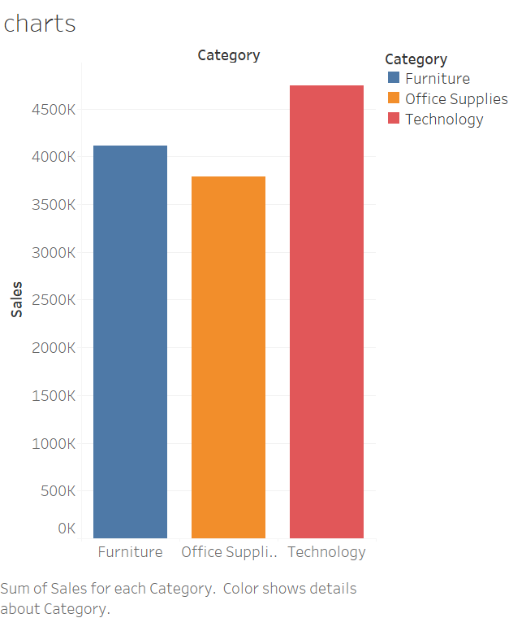
Bar graph
Description: Displays data as rectangular bars with lengths proportional to the values they represent.
Uses: Comparing categorical data, ranking, showing individual item values.
Example: Comparing sales figures across different regions.
How to Create:
Drag a dimension (e.g., Category) to the Rows shelf.
Drag a measure (e.g., Sales) to the Columns shelf.
Tableau automatically creates a bar chart.

Slide 35
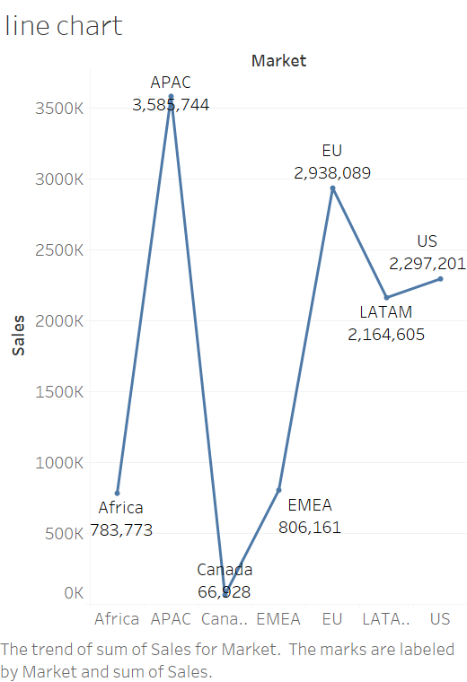
Line Chart
Description: Displays data points connected by lines, often used to show trends over time.
Uses: Trend analysis, time series data.
Example: Showing monthly sales trends over a year.
How to Create:
Drag a date dimension (e.g., Order Date) to the Columns shelf.
Drag a measure (e.g., Sales) to the Rows shelf.
Tableau automatically creates a line chart.

Slide 36
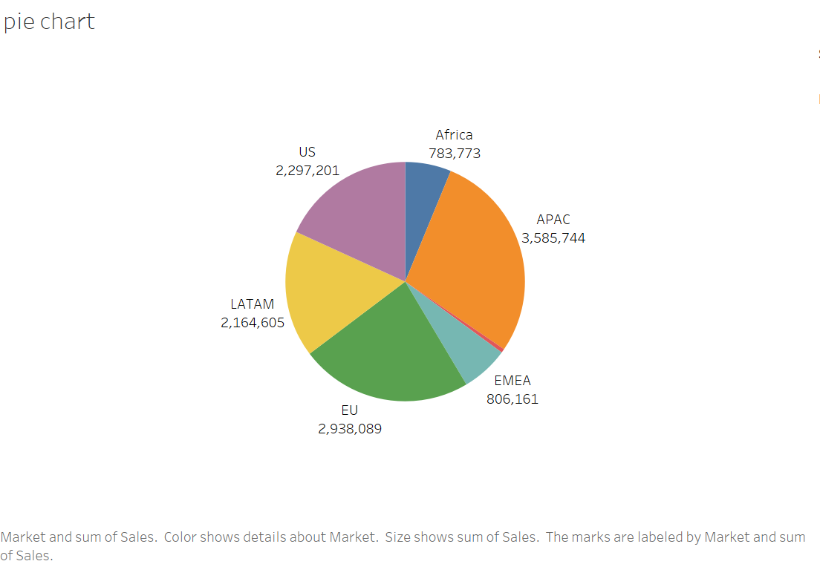
Pie Chart
Description: Displays data as slices of a circle, with each slice representing a proportion of the whole.
Uses: Showing proportions, parts-to-whole relationships.
Example: Market share of different products.
How to Create:
Drag a dimension (e.g., Category) to the Color shelf.
Drag a measure (e.g., Sales) to the Angle shelf.
Select Pie Chart from the Show Me panel.

Slide 37
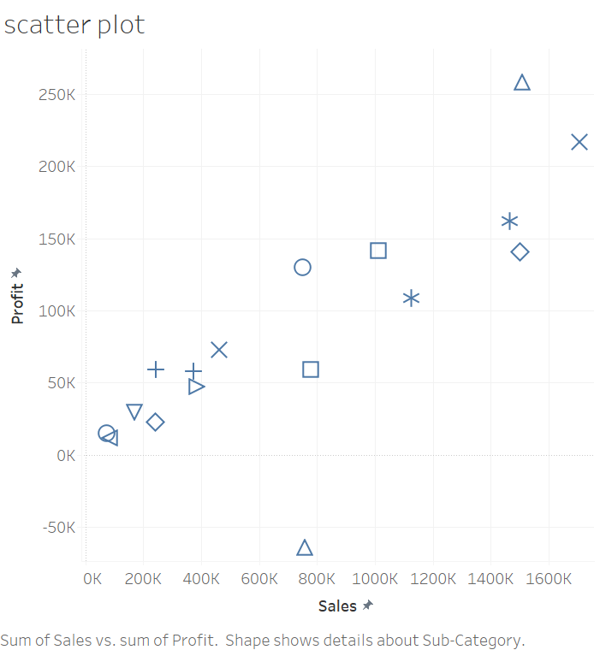
Scatter Plot
Description: Displays data points on a two-dimensional plane, showing relationships between two measures.
Uses: Correlation analysis, outlier detection.
Example: Analyzing the relationship between sales and profit.
How to Create:
Drag one measure (e.g., Sales) to the Columns shelf.
Drag another measure (e.g., Profit) to the Rows shelf.
Tableau automatically creates a scatter plot.

Slide 38
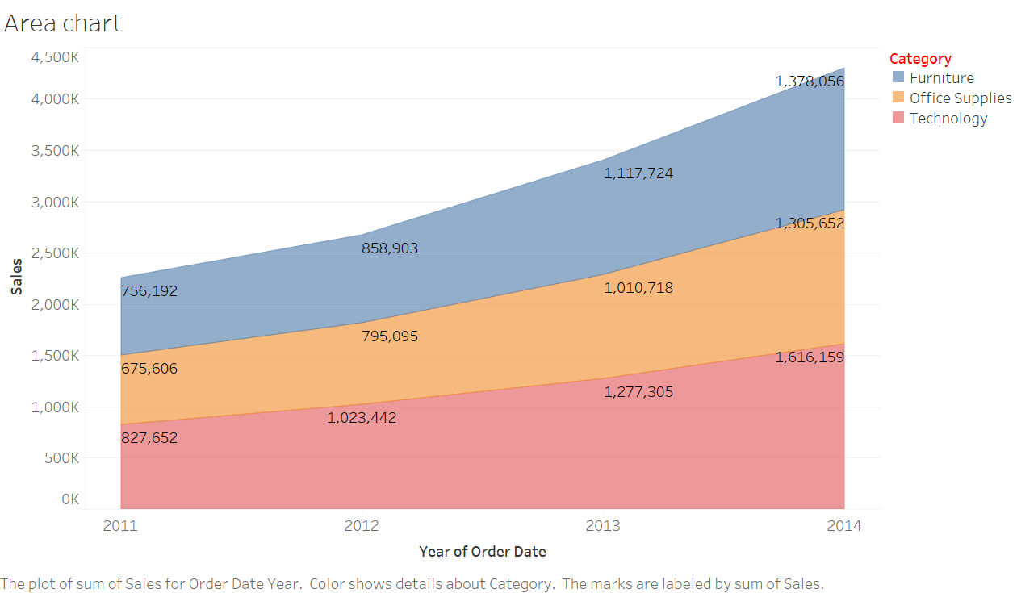
Area Chart
Description: Similar to a line chart, but the area under the line is filled.
Uses: Showing cumulative data, part-to-whole relationships over time.
Example: Cumulative sales over time.
How to Create:
Drag a date dimension (e.g., Order Date) to the Columns shelf.
Drag a measure (e.g., Sales) to the Rows shelf.
Select Area Chart from the Show Me panel.

Slide 39
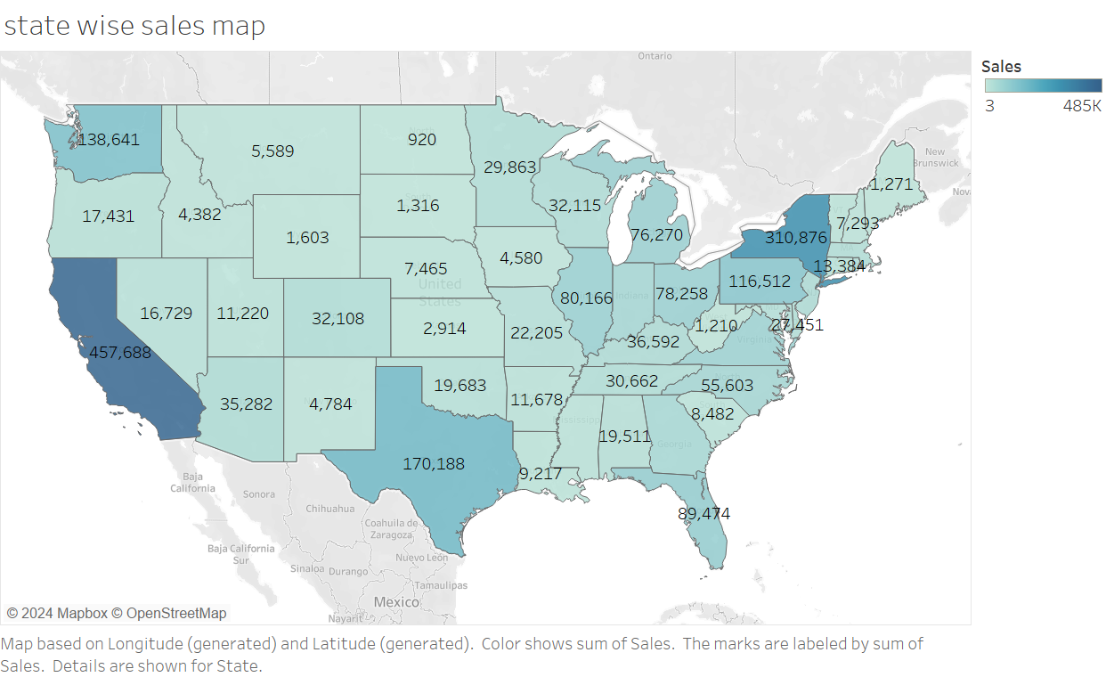
Map
Description: Displays data geographically on a map.
Uses: Geographic analysis, location-based data insights.
Example: Sales by state or country.
How to Create:
Drag a geographic field (e.g., State) to the view.
Drag a measure (e.g., Sales) to the Color shelf.
Tableau automatically creates a map.

Slide 40
Waterfall chart
Waterfall Chart
Description: A waterfall chart visualizes the cumulative effect of sequentially introduced positive or negative values. Each bar represents a data point, showing how an initial value is affected by intermediate positive and negative changes, ultimately leading to a final value.
Uses:
Financial Analysis: Displaying how revenue or profit changes due to various factors like costs and expenses.
Inventory Analysis: Demonstrating the changes in stock levels with incoming and outgoing items.
Process Improvement: Illustrating the impact of different stages on a key metric.
Example: Showing the impact of various expenses and incomes on the starting revenue to reach the ending revenue.

Slide 41
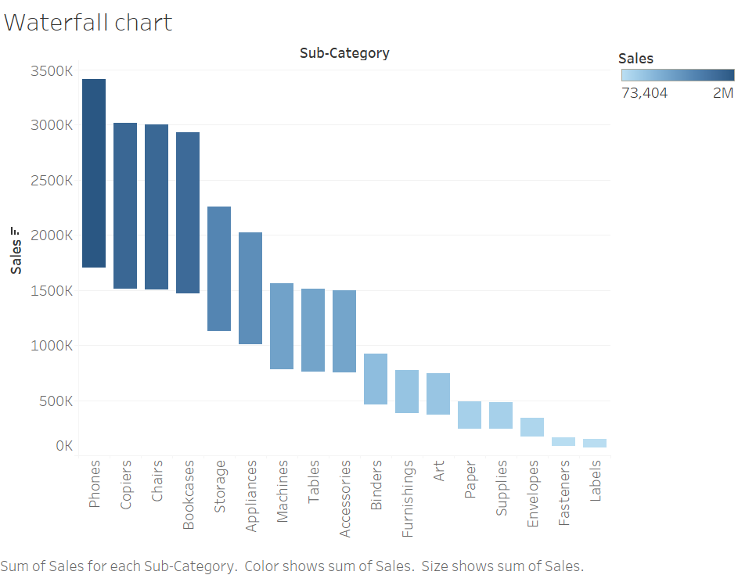

Slide 42
How to Create:
Create a Calculated Field for Running Total -> Go to the Data pane, right-click, and select Create Calculated Field.
Name it something like Running Total.Use the following formula:
RUNNING_SUM(SUM([Value]))
Build the Basic Chart:
Drag your Category dimension to the Columns shelf. -> Drag your Value measure to the Rows shelf.
Convert to Gantt Bar Chart: ->Change the mark type from Automatic to Gantt Bar in the Marks card.
Add Running Total to Size:->Drag the Running Total calculated field to the Size shelf in the Marks card.
Adjust the Size: ->You might need to adjust the size of the bars to make them more visible. You can do this by clicking on the Size shelf and adjusting the slider.
Color Coding:->To differentiate between positive and negative changes, drag the Value field to the Color shelf. Tableau will color the bars differently based on whether the values are positive or negative.
Formatting:->Adjust the colors, labels, and tooltips to improve readability.
Add labels by dragging the Value field to the Label shelf in the Marks card.
Refinement:->You can add reference lines or annotations to provide more context.
Ensure your axis and chart titles are descriptive.

Slide 43
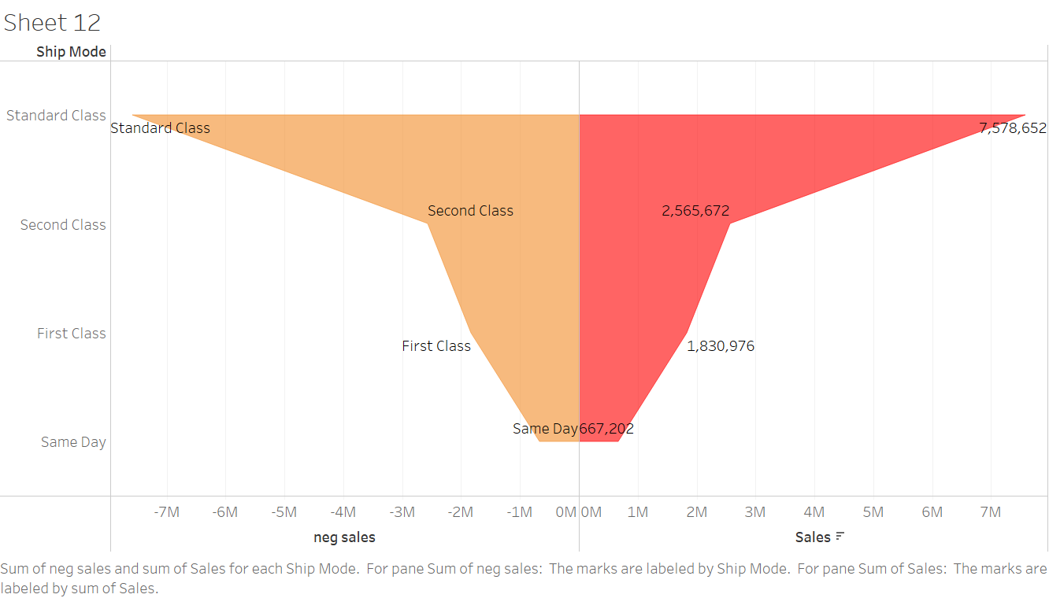
Funnel Chart
A funnel chart is used to visualize the progressive reduction of data as it passes from one phase to another. It is typically used to represent stages in a process, where each stage is represented by a portion of the funnel.
Uses: Sales Pipeline: Visualizing stages from leads to conversions.
Marketing Funnels: Showing steps in a campaign from awareness to purchase.
Process Analysis: Displaying the drop-off at each stage of a multi-step process.

Slide 44
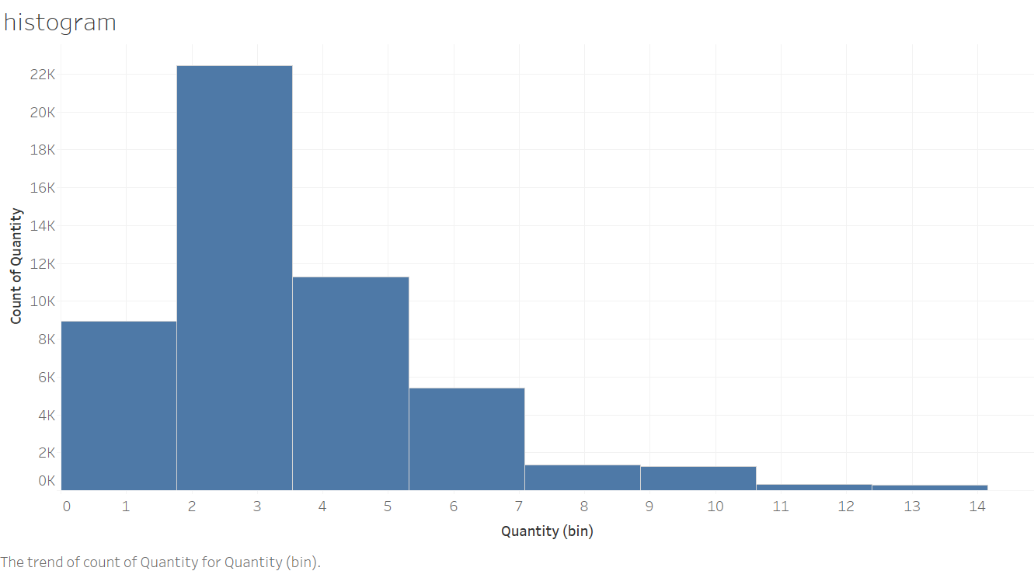
Histogram
Description: Displays the distribution of a continuous variable by dividing it into bins.
Uses: Frequency distribution, understanding the spread of data.
Example: Distribution of order quantities.
How to Create:
Drag a measure (e.g., Order Quantity) to the Columns shelf.
Select Histogram from the Show Me panel.

Slide 45
Tree map
Description: A tree map is a visualization that displays hierarchical data using nested rectangles. Each branch of the hierarchy is represented as a rectangle, containing smaller rectangles representing sub-branches. The size and color of each rectangle represent quantitative variables, making it easy to see patterns and compare sizes.
Uses:
Displaying Hierarchical Data: Visualizing data that has a hierarchical structure, such as organizational structures, file directories, or category breakdowns.
Comparing Proportions: Quickly showing the proportion of each category relative to the whole.
Identifying Patterns: Highlighting patterns and relationships in large datasets.
Example: Visualizing sales data for different product categories and subcategories, where the size of each rectangle represents the total sales and the color indicates profit margins.

Slide 46
Build the Basic Chart:
Drag the highest-level category dimension (e.g., Category) to the Rows shelf.
Drag the next level category dimension (e.g., Sub-Category) to the Rows shelf, placing it to the right of the first dimension.
Drag the measure you want to size the rectangles by (e.g., Sales) to the Columns shelf.
Convert to Tree Map:
Select Tree Map from the Show Me panel.
Color Coding:
Drag a measure (e.g., Profit) to the Color shelf to color the rectangles based on this measure.

Slide 47
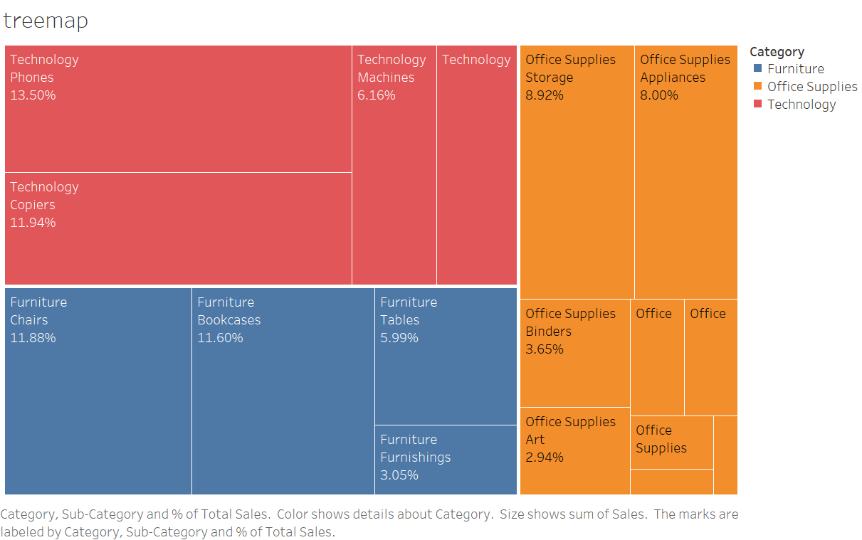

Slide 48
Bubble Chart
Description: A bubble chart is a type of chart that displays three dimensions of data. Each point is represented by a bubble, where the x-axis and y-axis represent two dimensions, and the size of the bubble represents the third dimension. It is useful for showing relationships and comparisons between three different variables.
Uses:
Comparing Relationships: Highlighting the relationship between three different variables.
Visualizing Data Density: Showing data density and distribution across different categories.
Identifying Outliers: Easily spotting outliers and patterns in the data.
Example: Visualizing sales performance where the x-axis represents sales, the y-axis represents profit, and the bubble size represents the number of orders.

Slide 49
Build the Basic Chart:
Drag the measure for the x-axis (e.g., Sales) to the Columns shelf.
Drag the measure for the y-axis (e.g., Profit) to the Rows shelf.
Convert to Bubble Chart:
Change the mark type from Automatic to Circle in the Marks card.
Add Bubble Size:
Drag the measure you want to use for bubble size (e.g., Number of Orders) to the Size shelf in the Marks card.
Color Coding (Optional):
Drag a dimension or measure (e.g., Region or Category) to the Color shelf to color-code the bubbles.

Slide 50
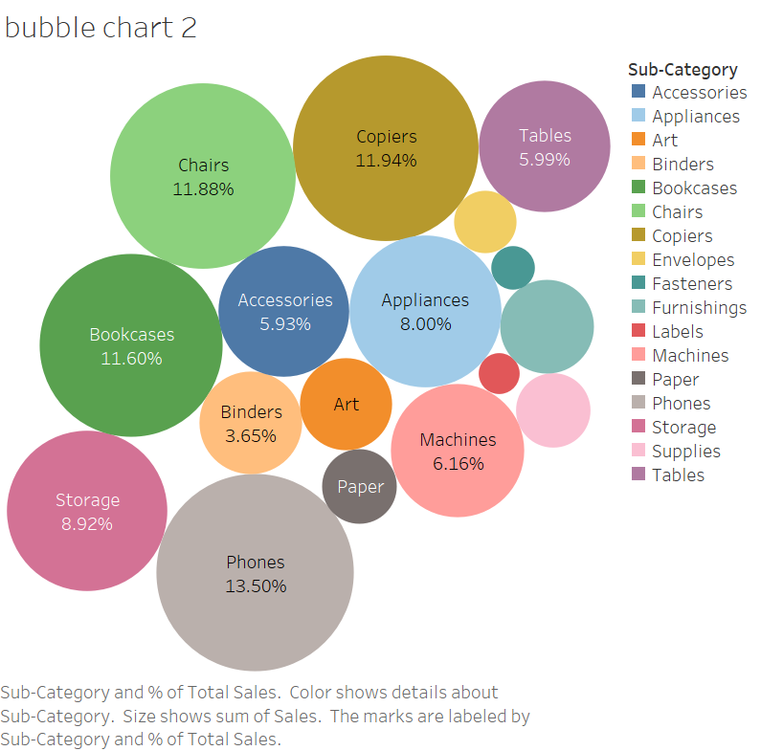

Slide 51
Word map (Word Cloud)
A word map, also known as a word cloud, is a visual representation of text data where the size of each word indicates its frequency or importance. It's a way to highlight the most prominent terms within a body of text.
Uses:
Text Analysis: Summarizing large text datasets by highlighting the most frequent words.
Marketing: Visualizing customer feedback, reviews, or social media mentions to understand common themes.
Content Creation: Identifying key topics or keywords in articles, blogs, or other written content.
Example: Visualizing the most common words in customer feedback to identify key areas of concern or satisfaction.

Slide 52
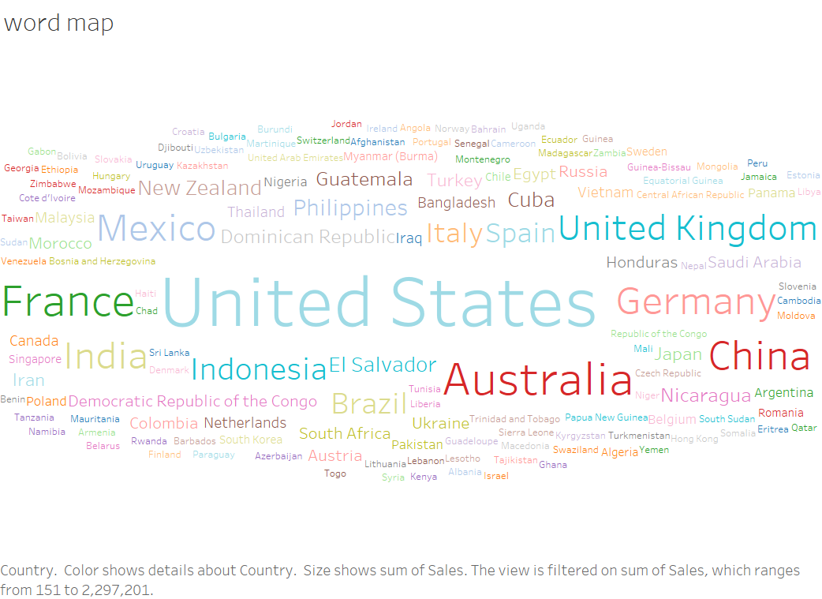

Slide 53
Box Plot
Description: A box plot, also known as a whisker plot, is a standardized way of displaying the distribution of data based on a five-number summary: minimum, first quartile (Q1), median (Q2), third quartile (Q3), and maximum. It shows the spread and skewness of the data and identifies outliers.
Uses:
Identifying Outliers: Easily spotting outliers in the data.
Understanding Distribution: Visualizing the spread and central tendency of data.
Comparing Distributions: Comparing distributions across different categories or groups.
Example: Visualizing the distribution of sales across different product categories to identify trends, outliers, and the overall distribution.

Slide 54
Build the Basic Chart:
Drag the dimension you want to categorize by (e.g., Category) to the Columns shelf.
Drag the measure you want to analyze (e.g., Sales) to the Rows shelf.
Convert to Box Plot:
Select the box plot option from the Show Me panel. If it's not directly available, ensure you have an axis for the measure and the dimension set up as described above.
Add Box Plot:
If the box plot does not automatically appear, you can manually add it:
Right-click on the axis of the measure (e.g., Sales) and select Add Reference Line.
Choose Box Plot from the reference line options.

Slide 55
A box plot, also known as a whisker plot, is a graphical representation of data that shows the distribution and variability of a dataset. It highlights key statistical measures and helps identify outliers. Here are the important points and terms to understand:
Minimum:
The smallest data point excluding any outliers.
Represented by the lower end of the whisker.
First Quartile (Q1):
Also known as the lower quartile, it marks the 25th percentile of the data.
This is the median of the lower half of the dataset.
The bottom edge of the box.
Median (Q2)
The middle value of the dataset, dividing it into two equal parts.
Also known as the second quartile or the 50th percentile.
Represented by a line inside the box.

Slide 56
Third Quartile (Q3):
Also known as the upper quartile, it marks the 75th percentile of the data.
This is the median of the upper half of the dataset.
The top edge of the box.
Maximum:
The largest data point excluding any outliers.
Represented by the upper end of the whisker.
Interquartile Range (IQR):
The range between the first quartile (Q1) and the third quartile (Q3).
IQR = Q3 - Q1
It measures the spread of the middle 50% of the data.
A larger IQR indicates more variability in the middle 50% of the data.
Whiskers:
Lines extending from the box to the smallest and largest values within 1.5 * IQR from the first and third quartiles, respectively.
They show the range of the data excluding outliers.

Slide 57
Outliers:
Data points that fall outside 1.5 * IQR above the third quartile or below the first quartile.
Represented as individual points beyond the whiskers.
They indicate variability and potential anomalies in the data.
Box:
The main part of the box plot, representing the IQR.
Contains 50% of the data points, providing a visual representation of data spread and central tendency.
Visual Representation
The box in the box plot represents the middle 50% of the data (IQR).
The line inside the box is the median (Q2).
The whiskers extend to the minimum and maximum values within 1.5 * IQR from Q1 and Q3, respectively.
Outliers are plotted as individual points beyond the whiskers.

Slide 58
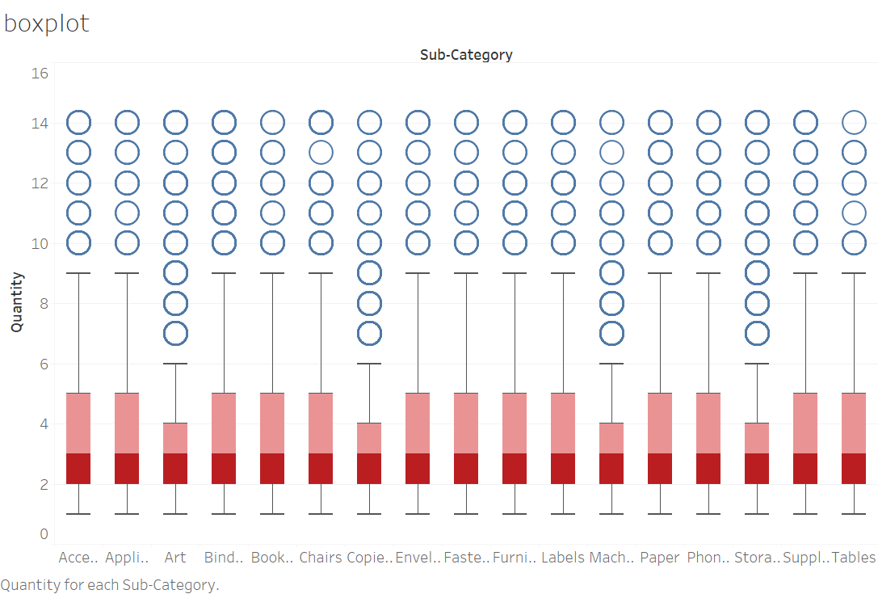

Slide 59
Actions
Actions are interactive elements that allow users to control the behavior of their dashboards and worksheets. Actions can be used to create interactive and dynamic visualizations, enhancing user experience and providing deeper insights. There are several types of actions in Tableau, each serving different purposes:

Slide 60
Types of Actions in Tableau
Filter Actions:
Description: Allows users to filter data in one or more target sheets based on selections in a source sheet.
Use Case: Click on a region in a map to filter a bar chart to show data only for that region.

Slide 61
Highlight Actions:
Highlight Actions: Description: Highlights related data across multiple views when a user hovers or clicks on a data point in the source sheet.
Use Case: Hover over a category in a bar chart to highlight the corresponding data points in a scatter plot.

Slide 62
URL Actions:
Description: Opens a webpage or another resource based on selections in the source sheet.
Use Case: Click on a customer name to open their profile page in a web browser.

Slide 63
Go to Sheet Actions:
Description: Navigates from one sheet to another within a dashboard or workbook.
Use Case: Click on a summary chart to navigate to a detailed view of the data.

Slide 64
Go to URL Actions:
Description: Similar to URL actions, but specifically used to navigate to external web pages directly.
Use Case: Click on a specific data point to navigate to a related web page for more information.

Slide 65
Dashboard in Tableau
Definition:
A dashboard in Tableau is a collection of multiple views, visualizations, and other objects, such as images, text, and web pages, arranged on a single canvas to provide an at-a-glance overview of data. Dashboards are used to combine related data from various sources and present it in a cohesive, interactive format.
Uses:
Data Visualization: Displaying multiple visualizations that represent different aspects of the data.
Interactivity: Allowing users to interact with the data through filters, highlights, and actions.
Storytelling: Communicating a data-driven narrative by combining various visualizations.
Decision Making: Providing actionable insights to help stakeholders make informed decisions.

Slide 66
Components of a Dashboard:
Views/Visualizations: Different charts, graphs, and maps created in Tableau.
Filters: Interactive controls that allow users to filter data across all views on the dashboard.
Parameters: User-defined controls that dynamically change the visualizations.
Legends: Keys that explain the colors, shapes, or sizes used in the visualizations.
Text: Annotations, titles, captions, or instructions added to the dashboard.
Images: Static graphics such as logos or explanatory images.
Web Pages: Embedded web content that provides additional context or information.
Actions: Interactive elements like filter actions, highlight actions, and URL actions that add interactivity to the dashboard.

Slide 67
Conclusion
Dashboards in Tableau are powerful tools for integrating multiple data visualizations into a single, interactive, and informative display. They enable users to explore data from various perspectives, derive insights, and make data-driven decisions effectively. By understanding how to create and use dashboards, you can maximize the impact of your data analysis and visualization efforts.

Slide 68
Story Points in Tableau
Definition:
Story points in Tableau are a way to create a sequence of visualizations that work together to convey a narrative or guide users through an analysis. A story is a collection of sheets or dashboards arranged in a specific order, providing context and driving a specific message or insight.
Uses:
Data Storytelling: Presenting a data-driven narrative with a clear beginning, middle, and end.
Guided Analysis: Leading users through a step-by-step exploration of data.
Highlighting Key Insights: Emphasizing important findings and trends within the data.
Interactive Reports: Allowing users to interact with each step of the story for deeper insights

Slide 69
Components of a Story:
Story Points: Individual pages or slides within the story, each containing a visualization, text, or a combination.
Navigator: A toolbar that allows users to move between story points.
Annotations: Text boxes or callouts used to explain each story point.
Conclusion
Story points in Tableau are an effective way to create a narrative flow that guides users through an analysis, helping to highlight key insights and drive home specific messages. By structuring your data in a story format, you can enhance the impact of your visualizations and provide a more engaging and informative experience for your audience.

Slide 70
Joins
Joins in Tableau are used to combine data from multiple tables into a single data source. This allows you to analyze and visualize data from different sources together. Tableau supports several types of joins, each with a specific purpose and use case.
Types of Joins
Inner Join:
Description: Returns only the rows where there is a match in both joined tables.
Use Case: When you need to analyze only the common data between two tables.
Example: Combining customer data with sales data where both tables have matching customer IDs.

Slide 71
Left Join:
Description: Returns all rows from the left table and the matched rows from the right table. Unmatched rows from the right table will have NULL values.
Use Case: When you want to retain all data from the primary table and add related data from the secondary table.
Example: Combining a list of all products (left table) with sales data (right table) to show all products, including those that have not been sold.
Right Join:
Description: Returns all rows from the right table and the matched rows from the left table. Unmatched rows from the left table will have NULL values.
Use Case: When you want to retain all data from the secondary table and add related data from the primary table.
Example: Combining sales data (right table) with customer data (left table) to show all sales, including those made to customers not in the customer list.

Slide 72
Full Outer Join:
Description: Returns all rows when there is a match in one of the tables. Unmatched rows will have NULL values for the missing columns.
Use Case: When you need a complete view of data from both tables, including unmatched rows from either table.
Example: Combining customer data with sales data to show all customers and all sales, including customers with no sales and sales with no customer information.

